Slide 1
1st Proposal
Date : 11/24, 2023
Group members : 李宣瑩 黃文龍 王采筑

Slide 2
Outline
Concept | 3
Flow Chart | 4
Tiny ML | 5
Development Process | 6
Schedule | 7

Slide 3



Concept
Basic conception:
Take picture
Binary classification: Is “YA” or “Others”
Response the result to take action
是YA!
不是YA!

Slide 4
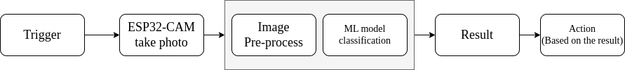
Flow Chart

Slide 5
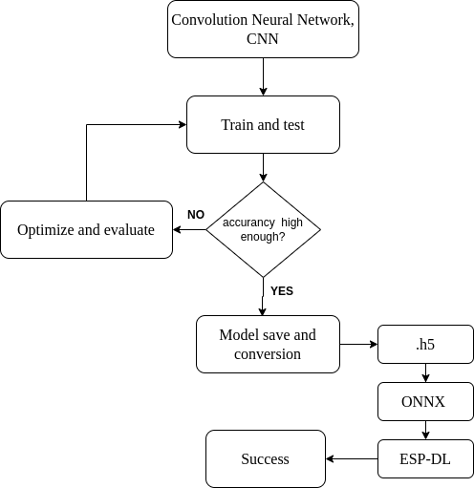
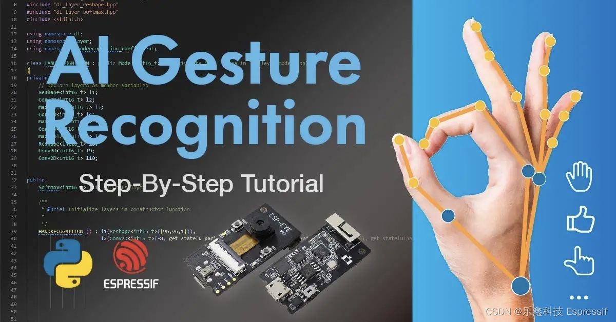
Tiny ML
ESP32 Implementation Example
https://github.com/sunnychugh/tensorflow
使用 ESP-DL 深度学习库基于 ESP32-S3 实现手势识别
Notes:
CNN with 3 Convolution Layer
5 epochs
Model save and conversion form .h5 zu ONXX

Slide 6
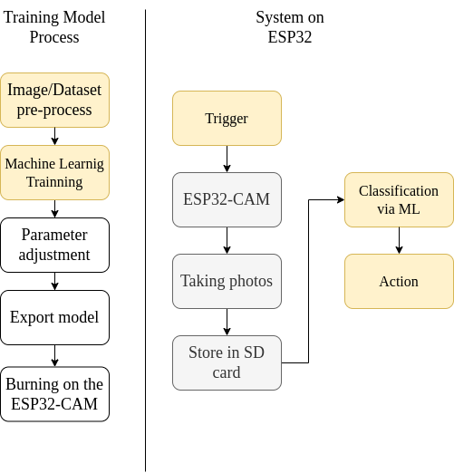
Development Process

Slide 7
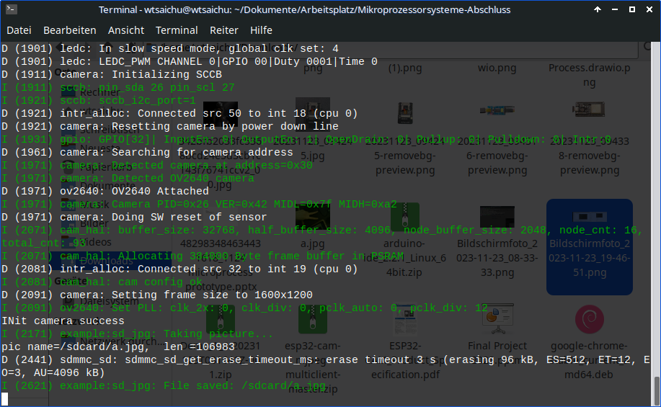
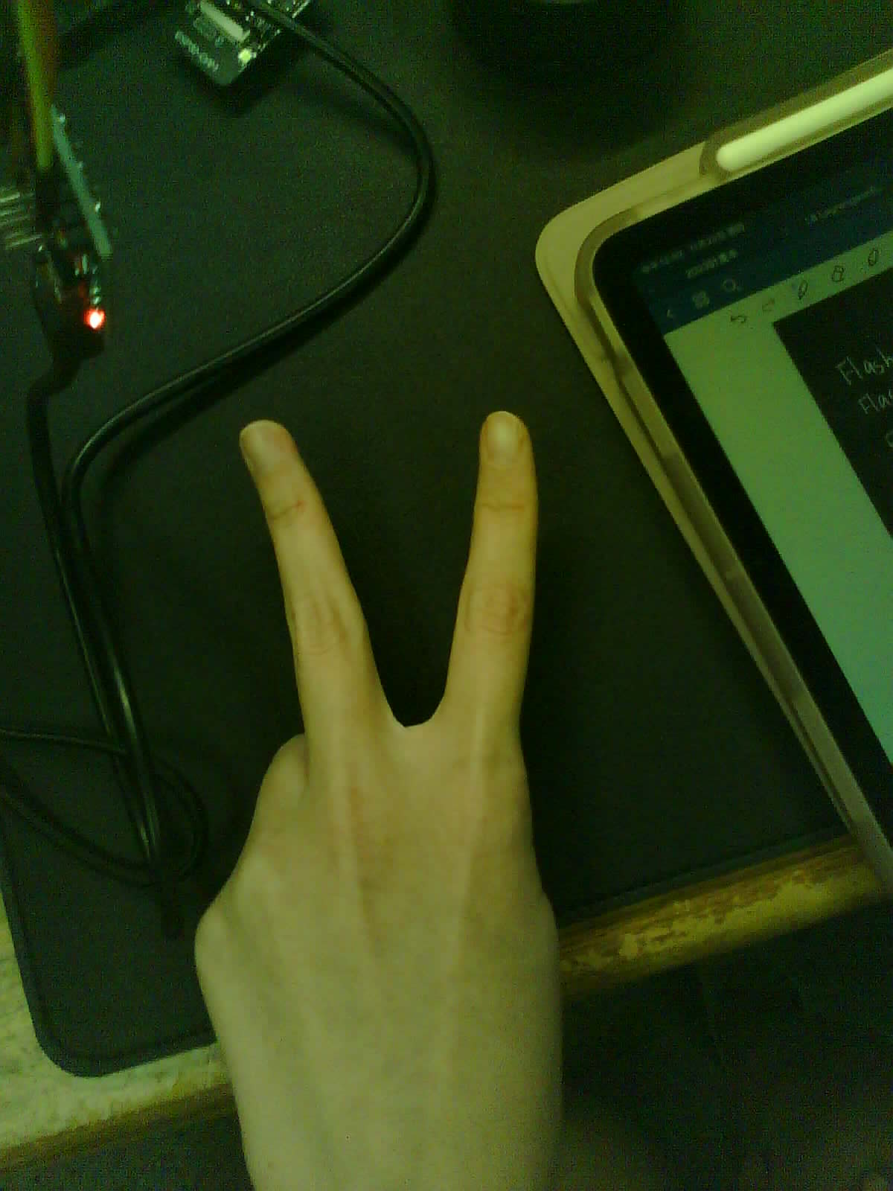
Schedule

